Slide 1
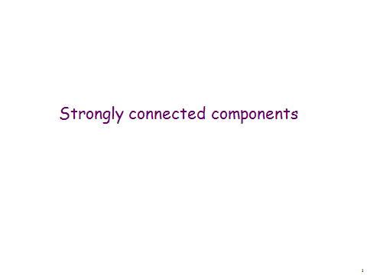

Slide 2
Connectivity
Definition: A path of length n from u to v, where n is a positive integer, in an undirected graph is a sequence of edges e₁, e₂, …, e_{n} of the graph such that e₁ = {x₀, x₁}, e₂ = {x₁, x₂}, …, e_{n} = {x_{n-1}, x_{n}}, where x₀ = u and x_{n} = v.
When the graph is simple, we denote this path by its vertex sequence x₀, x₁, …, x_{n}, since it uniquely determines the path.
The path is a circuit if it begins and ends at the same vertex, that is, if u = v.

Slide 3
Connectivity
Definition (continued): The path or circuit is said to pass through or traverse x₁, x₂, …, x_{n-1}.
A path or circuit is simple if it does not contain the same edge more than once.

Slide 4
Connectivity
Let us now look at something new:
Definition: An undirected graph is called connected if there is a path between every pair of distinct vertices in the graph.
For example, any two computers in a network can communicate if and only if the graph of this network is connected.
Note: A graph consisting of only one vertex is always connected, because it does not contain any pair of distinct vertices.

Slide 5
Connectivity
Example: Are the following graphs connected?
a
b
a
b
e
e
d
d
c
c
Yes.
No.
a
b
a
b
e
e
d
c
d
f
c
Yes.
No.

Slide 6
Connectivity
Definition: A graph that is not connected is the union of two or more connected subgraphs, each pair of which has no vertex in common. These disjoint connected subgraphs are called the connected components of the graph.
Definition: A connected component of a graph G is a maximal connected subgraph of G.
E.g., if vertex v in G belongs to a connected component, then all other vertices in G that is connected to v must also belong to that component.

Slide 7
Connectivity
Example: What are the connected components in the following graph?
i
h
d
a
e
g
b
c
f
j
Solution: The connected components are the graphs with vertices {a, b, c, d}, {e}, {f}, {i, g, h, j}.

Slide 8
Connectivity
Definition: An directed graph is strongly connected if there is a path from a to b and from b to a whenever a and b are vertices in the graph.
Definition: A directed graph is called weakly connected if replacing all of its directed edges with undirected edges produces a connected (undirected) graph. It is connected if it contains a directed path from u to v or a directed path from v to u for every pair of vertices u,v.

Slide 9
Connectivity
Example: Are the following directed graphs strongly or weakly connected?
a
Weakly connected, because, for example, there is no path from b to d.
b
d
c
a
Strongly connected, because there are paths between all possible pairs of vertices.
b
d
c

Slide 10
Cut vertices and edges
If one can remove a vertex (and all incident edges) and produce a graph with more components, the vertex is called a cut vertex or articulation point.
Similarly if removal of an edge creates more components the edge is called a cut edge or bridge.

Slide 11
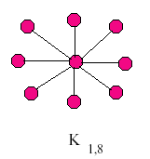
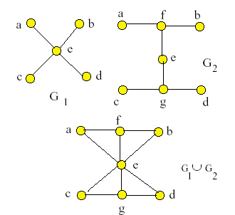
In the star network the
center vertex is a cut vertex.
All edges are cut edges.
In the graphs G₁ and G₂ every edge is a cut edge.
In the union, no edge is a cut edge.
Vertex e is a cut vertex in all graphs.

Slide 12
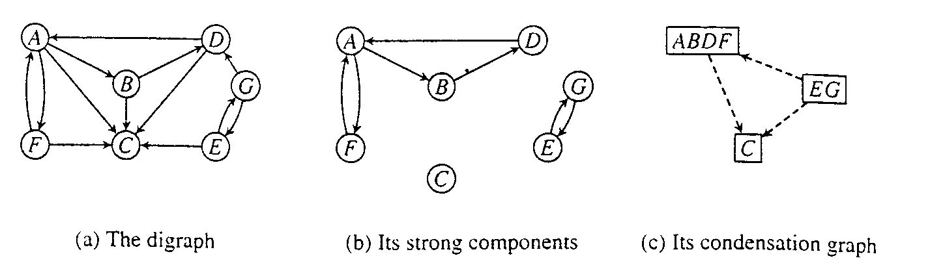
Strongly Connected Components of a Digraph
Strongly connected:
  A directed graph is strongly connected if and only if, for each pair of vertices v and w, there is a path from v to w.
Strongly connected component:
  A strongly connected component of a digraph G is a maximal strongly connected subgraph of G.

Slide 13
Condensation graph and its strongly connected components
Condensation Graph is acyclic.

Slide 14
Component Graph
G^{SCC} = (V^{SCC}, E^{SCC}).
V^{SCC} has one vertex for each SCC in G.
E^{SCC} has an edge if there’s an edge between the corresponding SCC’s in G.
G^{SCC} for the example considered:

Slide 15
Transpose of a Directed Graph
G^{T} = transpose of directed G.
  G^{T} = (V, E^{T}), E^{T} = {(u, v) : (v, u) ∈ E}.
  G^{T} is G with all edges reversed.
Can create G^{T} in Θ(V + E) time if using adjacency lists.
G and G^{T} have the same SCC’s. (u and v are reachable from each other in G if and only if reachable from each other in G^{T}.)

Slide 16
Algorithm to determine SCCs
SCC(G)
call DFS(G) to compute finishing times f [u] for all u
compute G^{T}
call DFS(G^{T}), but in the main loop, consider vertices in order of decreasing f [u] (as computed in first DFS).If the depth-first search does not reach all vertices, start the next depth-first search from the hightest-numbered reaming vertex.
output the vertices in each tree of the depth-first forest formed in second DFS as a separate SCC
Time: Θ(V + E).

Slide 17
Example
G
a
b
c
d
13/14
11/16
1/10
8/9
12/15
3/4
2/7
5/6
e
f
g
h

Slide 18
Example
G^{T}
a
b
c
d
e
f
g
h

Slide 19
Example
cd
abe
fg
h

Slide 20
How does it work?
Idea:
  By considering vertices in second DFS in decreasing order of finishing times from first DFS, we are visiting vertices of the component graph in topologically sorted order.
  Because we are running DFS on G^{T}, we will not be visiting any v from a u, where v and u are in different components.
Notation:
  d[u] and f [u] always refer to first DFS.
  Extend notation for d and f to sets of vertices U ⊆ V:
  d(U) = min_{u∈U}{d[u]} (earliest discovery time)
  f (U) = max_{u∈U}{ f [u]} (latest finishing time)

Slide 21
END

